Slide 2



Announcements
DMU HACKERS
Gradcracker
Red v Blue
Memberships
Hoodies
Internships
CTF Club venue change

Slide 3

DMU
Hacking Society
Anonymity

Slide 4


DMUHACKERS
D0nt d0 1ll3gal sh1t
please..

Slide 5
An OSINT investigator just found your address, job, mum’s phone number, and your dog’s name… In under 15 minutes.
Could you have prevented it?
DMU HACKERS

Slide 6
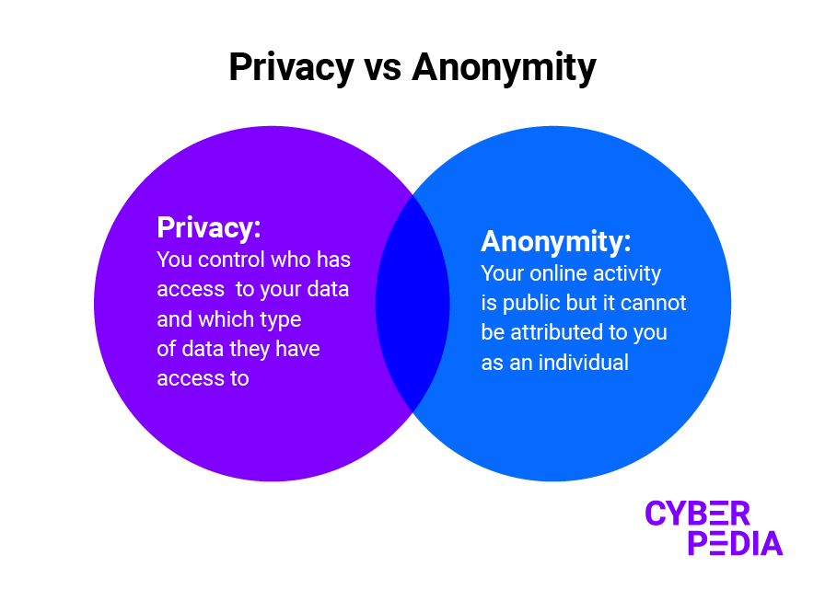
Privacy vs Anonymity
DMU HACKERS
Privacy:
Controlling what others know about you
Anonymity:
Hiding who you are when interacting

Slide 7
Why does it matter? (I have nothing to hide)
DMU HACKERS
Prevent OSINT targeting
STOP GIVING GCHQ YOUR DATA YOU DRONE (I am not schitzo)
Avoid targeted phishing, doxxing and surveillance
Whistleblowing, activism or OPSEC
Hiring and background checks
You may not have a reason to cover your tracks now… but these things take a long time to hide and so some day you may thank yourself for preserving your PERSEC

Slide 8

Anonymity at a glance
DMU HACKERS
Make your social media accounts private
DON’T POST YOUR STRAVA RUNS PUBLIC…
Location tags may come back to bite
Case Study: Adam’s relative (X)

Slide 9
Can we do too much to hide…
DMU HACKERS
The beauty of our online presence is we can control it…
If we delete everything, that may make people look harder and find things that we don't want them to… like my shrine to GB News that I don't have…
We have to remember, it is normal to have a social presence, we should just present what we want it to show…

Slide 10
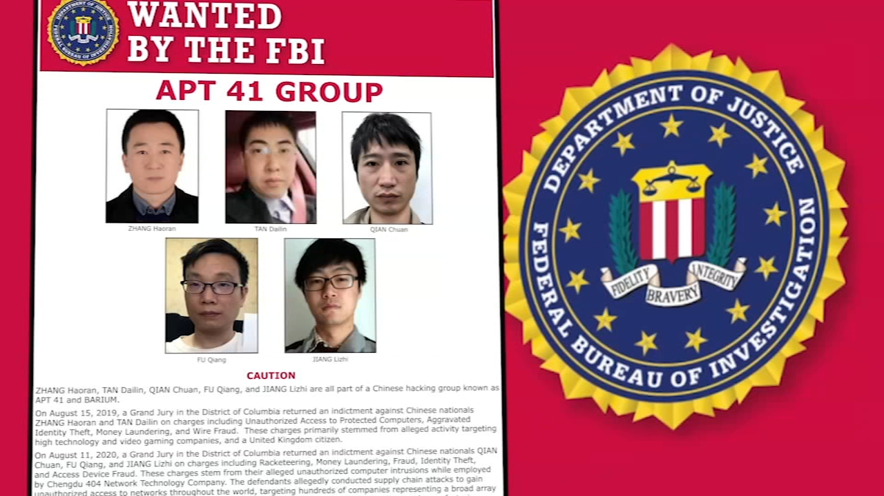
Threat Modelling
DMU HACKERS
When considering our anonymity, like in an organisation with their security, we need to do some CTI and work out certain things..
Level of threat:
Employer?
Hacker?
State Actor? (good luck)
Framework:
Who
What
Why
How

Slide 11

Footprints we leave
DMU HACKERS
Where is our data?
Social Media
Metadata
Browsing
Purchases
Devices
Fitness App activities
Reviews of locations
Data Breaches (Remember hash cracking…)
Geo-Int data
Governmental records
Where do you think you are leaking data?

Slide 12
OSINT Attack Examples
DMU HACKERS
Person of Interest (X) for this… ( hypothetical scenario…)
Found their username, this led me to their email
Using their profile pictures I could move laterally between accounts
With account names I could craft wordlists to find more usernames
With their Gsuite email I could see what they had reviewed…
They had reviewed their current student accom (rookie mistake)
Using google dorking, I could see everything that existed about them on the internet
Now i (could) find where they exist in data breaches and recover leaked passwords XD (i would never)

Slide 13
Privacy Hygiene - The Basics
DMU HACKERS
Aliases (for OSINT)
Privacy focused emails such as protonmail…
VPNs and Tor
Secure Browsers (Firefox)
Password Hygiene
There are many privacy guides out there that will help you to preserve your anonymity… Such as: PrivactGuides.org
“Remember, when creating “anonymous accounts” be careful not to have any traces to your personal credentials, and do not create accounts all at once, let them cool down to avoid suspicion…”

Slide 14

Browsing Anonymously
DMU HACKERS
Even without cookies… your browser sells you out.
Details such as:
OS, screen size, plugins
Timezone, fonts, languages
Hardware specs, canvas/webGL rendering
Combined = unique digital signature that identifies YOU
If you want to see your fingerprint, you can use:
https://coveryourtracks.eff.org/

Slide 15
Browsing Anonymously
DMU HACKERS
Tools for safer browsing:
Containers (Firefox Multi-Account Containers)
Isolate sessions (social, shopping, research)
NoScript / uMatrix
Block JS on unfamiliar sites
Control what loads (scripts, iframes, trackers)
uBlock Origin
Easy ad/tracker blocker
Lightweight, works well with other tools

Slide 16
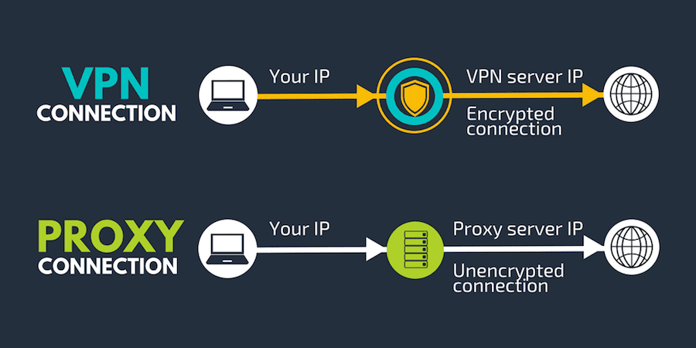
VPN Benefits
DMU HACKERS
A VPN or Virtual Private Network is a private tunnel through the public internet
Encrypts your internet traffic
Hides your IP address from websites
Routes your data through a VPN server in another location
What a VPN protects us from:
Local Snooping (Wi-Fi)
ISP tracking and rate limiting
Region-blocked content
Direct IP-based tracking

Slide 17
VPN Drawbacks
DMU HACKERS
A VPN does not:
Make you a certi rs3 anonymous hacker… or anonymous at all
Prevent website tracking (cookies, fingerprinting)
Protect you from malware/phishing
Hide your identity if you’re logged in via a service i.e. Google OAuth2
VPN Hygiene:
USE A GOOD VPN PROVIDER i.e. Mozilla or Mullvad
Avoid free VPNs - if you use one you are genuinely a melt
Don’t trust it because it says secure..

Slide 18

DMU HACKERS

Slide 19
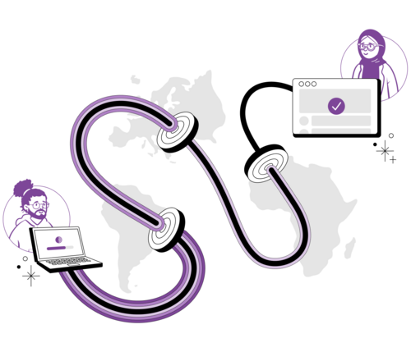
TOR
DMU HACKERS
TOR stands for The Onion Router, it works by anonymising your traffic through layers.
Decentralised network of independently controlled nodes, a TOR circuit travels via 3 nodes to obscure your traffic…
Created by the U.S. Navy for secure comms
Now maintained by the Tor Project

Slide 20
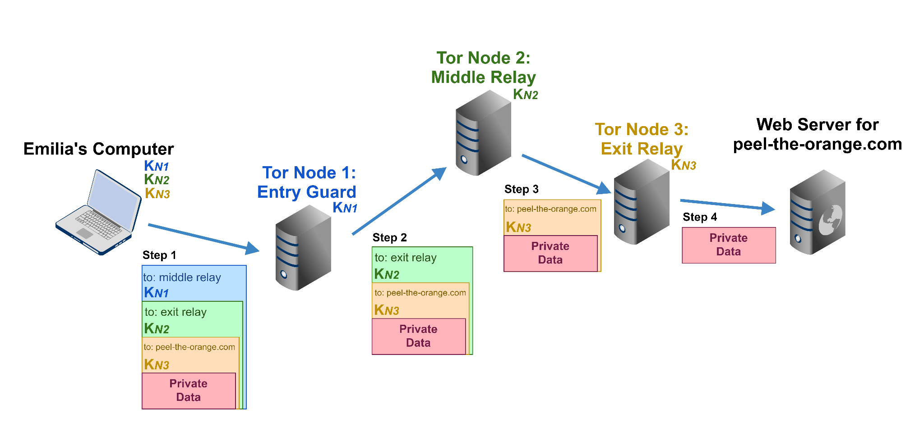
TOR
DMU HACKERS
Your data is encrypted in layers as below:
Entry Node: Sees your IP but not content you are accessing
Middle Node: Passes encrypted data, sees nothing..
Exit Node: Sees the destination server but not your source IP

Slide 21
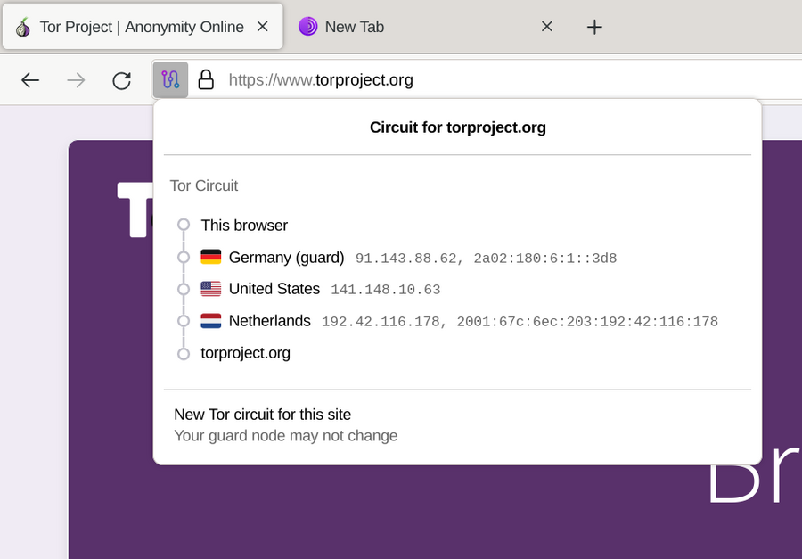
TOR
DMU HACKERS

Slide 22

TOR
DMU HACKERS
Your data is encrypted in layers as below:
Entry Node: Knows you but not what you’re doing
Middle Node: Blind router in the chain
Exit Node: Knows what you’re accessing but not who you are

Slide 23
TOR
DMU HACKERS
Risks & Realities of Tor:
Malicious exit nodes!!!!!!
Can sniff unencrypted traffic
May inject scripts or perform MITM attacks
Malicious entry nodes:
With global surveillance, entry-exit timing correlation is possible
Based on timing and volume and analysis
Not immune to fingerprinting or user error

Slide 24
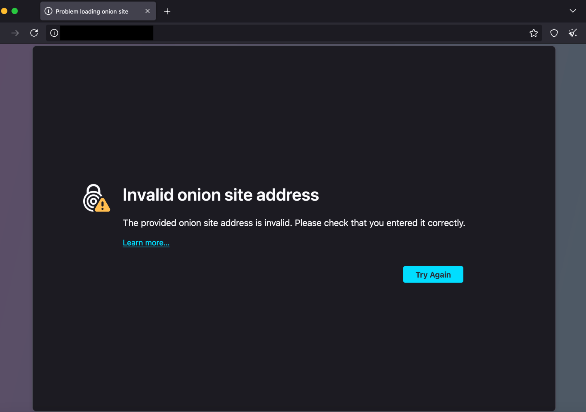

Onion Services (.onion)
DMU HACKERS
Hidden services only accessible via Tor
URL is a cryptographic hash (e.g. exp4npwhc6y72fxy.onion)
Allow for anonymous hosting and access
Uses rendezvous points inside Tor network - no direct connection between the client and server

Slide 25
Using Tor Effectively
DMU HACKERS
Never resize the window (fingerprint)
Don't install add-ons or change settings
Don't log into real accounts via Tor
Use HTTPS (HTTPS Everywhere or built-in HTTPS-only mode)
TL;DR:
Tor is powerful for anonymity…
It is not however invincible, use it wisely and with care

Slide 26
Tor vs VPN
DMU HACKERS
Feature | Tor | VPN
Traffic Routing | Multi-layered via Tor Relays | Encrypted tunnel to provider
Anonymity | High | Depends on provider
Speed | Slower | Faster
Browser Use | Built-in Firefox fork | Works with any app
Metadata Leaks | Minimal (if used properly) | VPN provider sees traffic metadata

Slide 27
DMU HACKERS
As a wise man once said:
“Thou who controls the nodes, controls the data” (i said that btw)
It is estimated that three (four) letter agencies control a large proportion of the nodes on the TOR network.
Therefore EVERYONE NEEDS TO RUN A NODE NOW

Slide 28

DMU HACKERS

Slide 29
TailsOS
DMU HACKERS
TailsOS is a lightweight operating system designed to leave no traces
Debian-based
Live OS (runs from a USB stick)
Runs in RAM (no traces after power off)
All network traffic forced through Tor by default
Includes various privacy tools:
Tor
KeePassXC (Password Vault)
GnuPG (GPG)
Metadata cleaner

Slide 30
TailsOS
DMU HACKERS
Tails is perfect for some lines of work…
Journalists
Whistleblowers
Activists under surveillance
Hackers doing OPSEC sensitive research
Tails is portable and ephemeral meaning we can take it anywhere, boot and vanish…
Another OS similar to this is Whonix - Featured in the series Day of the Jackal
Ephemeral = lasting for a very short time = Josh

Slide 31
TailsOS
DMU HACKERS
Limitations of tails….
Doesn’t support persistent browsing sessions unless configured
Can leak identity if not used carefully
Can look suspicious on forensic inspection (USB Boot)

Slide 32
Alternatives to Tails
DMU HACKERS
QubesOS (Edward Snowden)
Security through isolation… containerisation
A qube per activity/application
Whonix
Runs in 2 VMs
Workstation
Gateway
Kodachi Linux
Security focused distribution
More plug and play, less community trust than the others…

Slide 33
Burner Devices & Cold Ops
DMU HACKERS
“When you don't want anything to link back to you, go cold…”
Burner Phones & Prepaid SIMs
Cheap phones (old Nokia or cheap androids)
Buy with cash only - no loyalty cards and no ID
Use prepaid SIMs from vending machines or off-grid shops
Never associate with real accounts or contacts
Once again, the tools are there, your anonymity is purely down to how you conduct yourself and adhering to the procedures…

Slide 34
Burner Devices & Cold Ops
DMU HACKERS
Cold Device Protocols:
Boot in airplane mode, disable GPS
Never reuse SIMs or hardware across aliases
Wipe or destroy after use…
Use a faraday pouch to block all signals in and outbound from the device
Cold surfing Protocols:
Use public wifi never your home network
MAC spoofing + VPN + container browser i.e. Tor
Always assume CCTV + logging is in place

Slide 35
Burner Devices & Cold Ops
DMU HACKERS
If you think privacy is unimportant, ask yourself, why do governments work so hard to remove it
( i wrote this before the summer break… how relevant it has become )

Slide 36

Tools, tools and more tools
DMU HACKERS
Secure Communication:
Signal (E2E)
Session (No phone number!!! Very good)
Protonmail or Morke(Tor) - Encrypted emails
Passwords & Secrets:
KeePassXC - Offline
Bitwarden - Open-Source cloud option
Veracrypt - Encrypted Containers
Paper backups… arguably the best and worst simultaneously

Slide 37

Tools, tools and more tools
DMU HACKERS
Private browsing:
Librewolf (firefox without telemetry)
Tor Browser
Mullvad Browser (not tried)
Extensions:
NoScript
uBlock Origin
VPNs:
Mullvad (pay in cash)
Mozilla
Plus more… do your research

Slide 38

Privacy Guides & Communities
DMU HACKERS
Privacy Guides (Best)
https://www.privacyguides.org/en/
Surveillance Self Defence (Decent)
https://ssd.eff.org/
Reddit (weirdly decent)
r/privacy
r/imaparanoidschitzo (this one may be a lie)
r/opsec
r/degoogle

Slide 39

Practical
https://tryhackme.com/room/ohsint

Slide 40
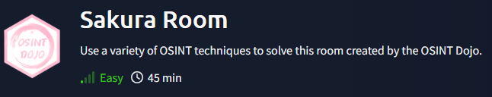
Practical
https://tryhackme.com/room/sakura

